Slide 1


List Flow
A Simple & Minimal To Do List App
Name-Suruchi Kumari
Roll No.-22IT3056
Branch-IT

Slide 2
Why are you using in To-do List App
I can understand why someone might find it useful. To-do list apps help people organize tasks, set priorities,and stay on track with their goals. They’re handy for managing both personal and professional responsibilities , keeping everything in one place and easily accessible. Plus many of them offer features like reminders, due date,and collaboration option,which can make managing tasks even easier. If yoy’re considering using one , it might be worth trying out a few different apps to see which one fits your needs best!

Slide 3
.TO-do list apps can be built using a variety of front-end and back-end tools depending on factors like the developer’s preferance, project requirements , scalability needs, and target platform. Here’s common stack that might be used.

Slide 4
Front-end:-
HTML
CSS
React.js
JavaScript
Back-end:-
Node.js
Express.js
MongoDB
Redux

Slide 5
.TASK MANAGEMENT:User can create,update,and delete their tasks & also can view their tasks in a User-Friendly interface. . USER AUTHENTICATION: Users can Sign Up and log in access their personalized To-Do List. .RESPONSIVE DESIGN:Compatible with various screen sizes for a seamless user experience. .INTUITIVE INTERFACE:User-Friendly dark minimal interface for easy task management.

Slide 6
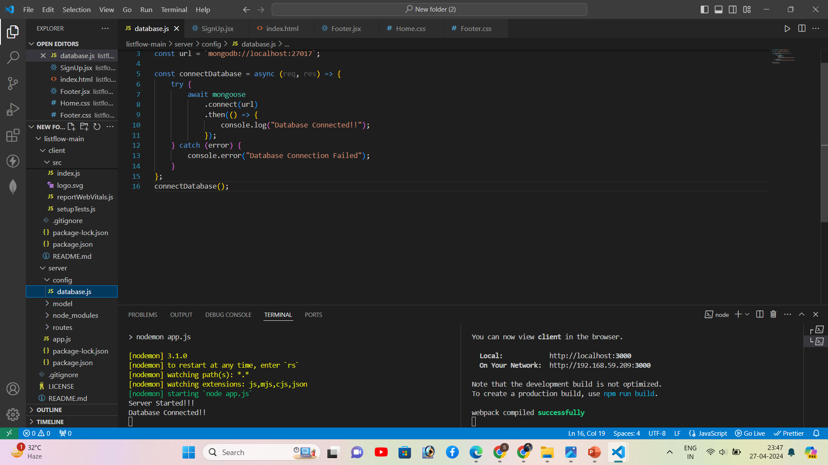

Slide 7
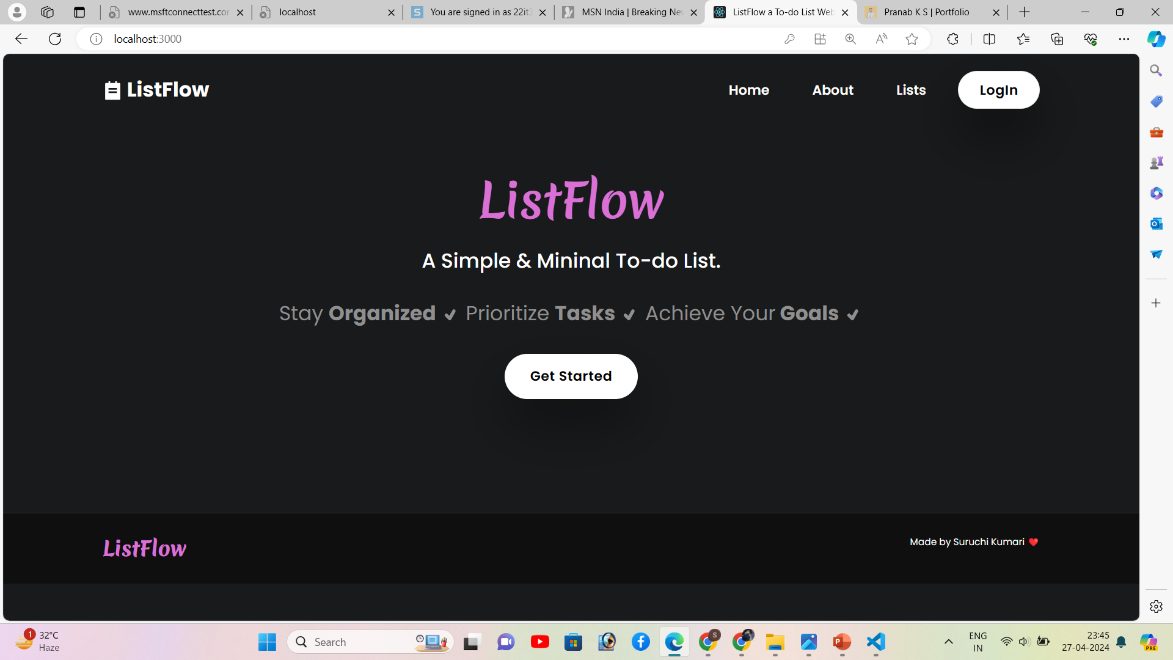

Slide 8
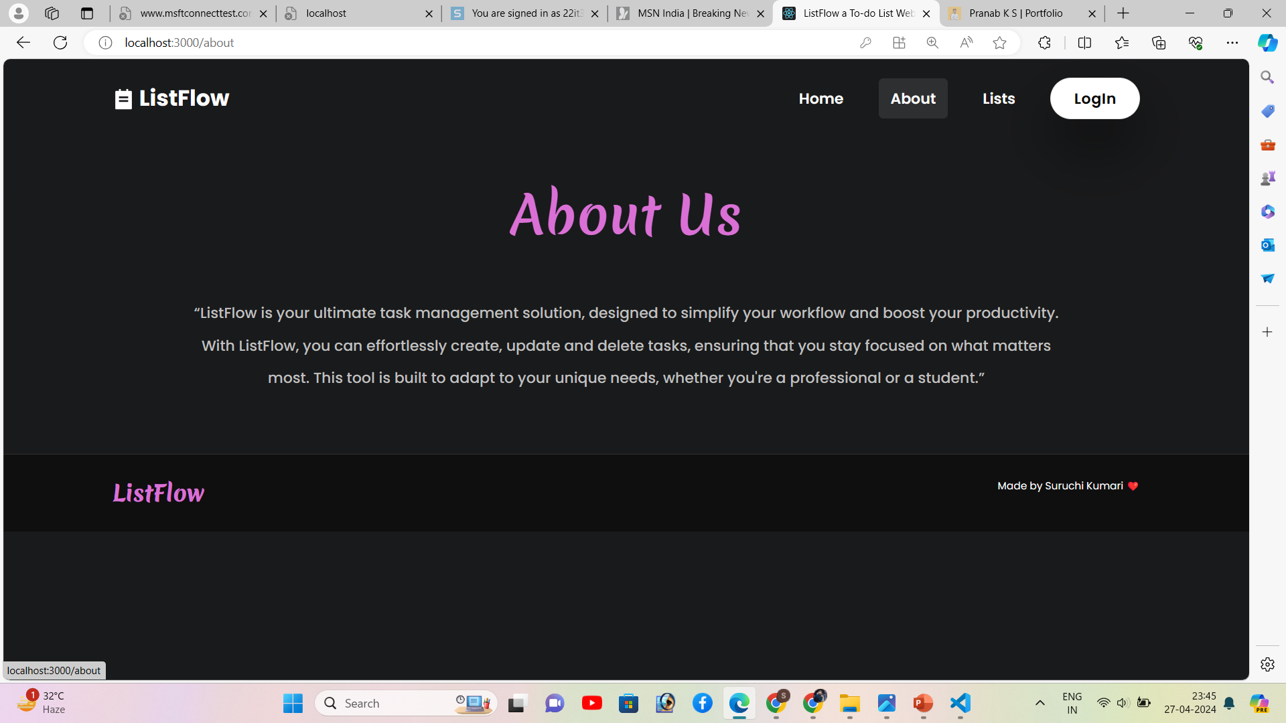

Slide 9
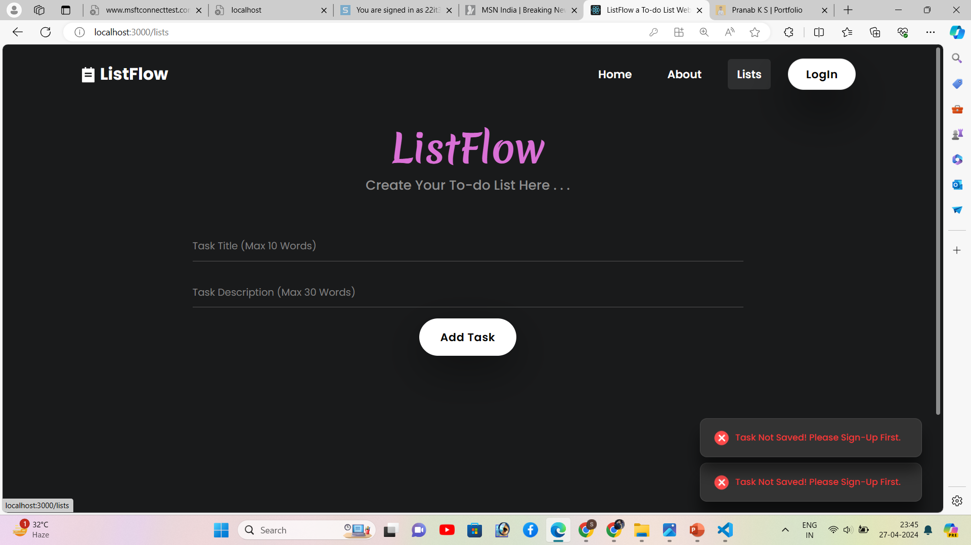

Slide 10
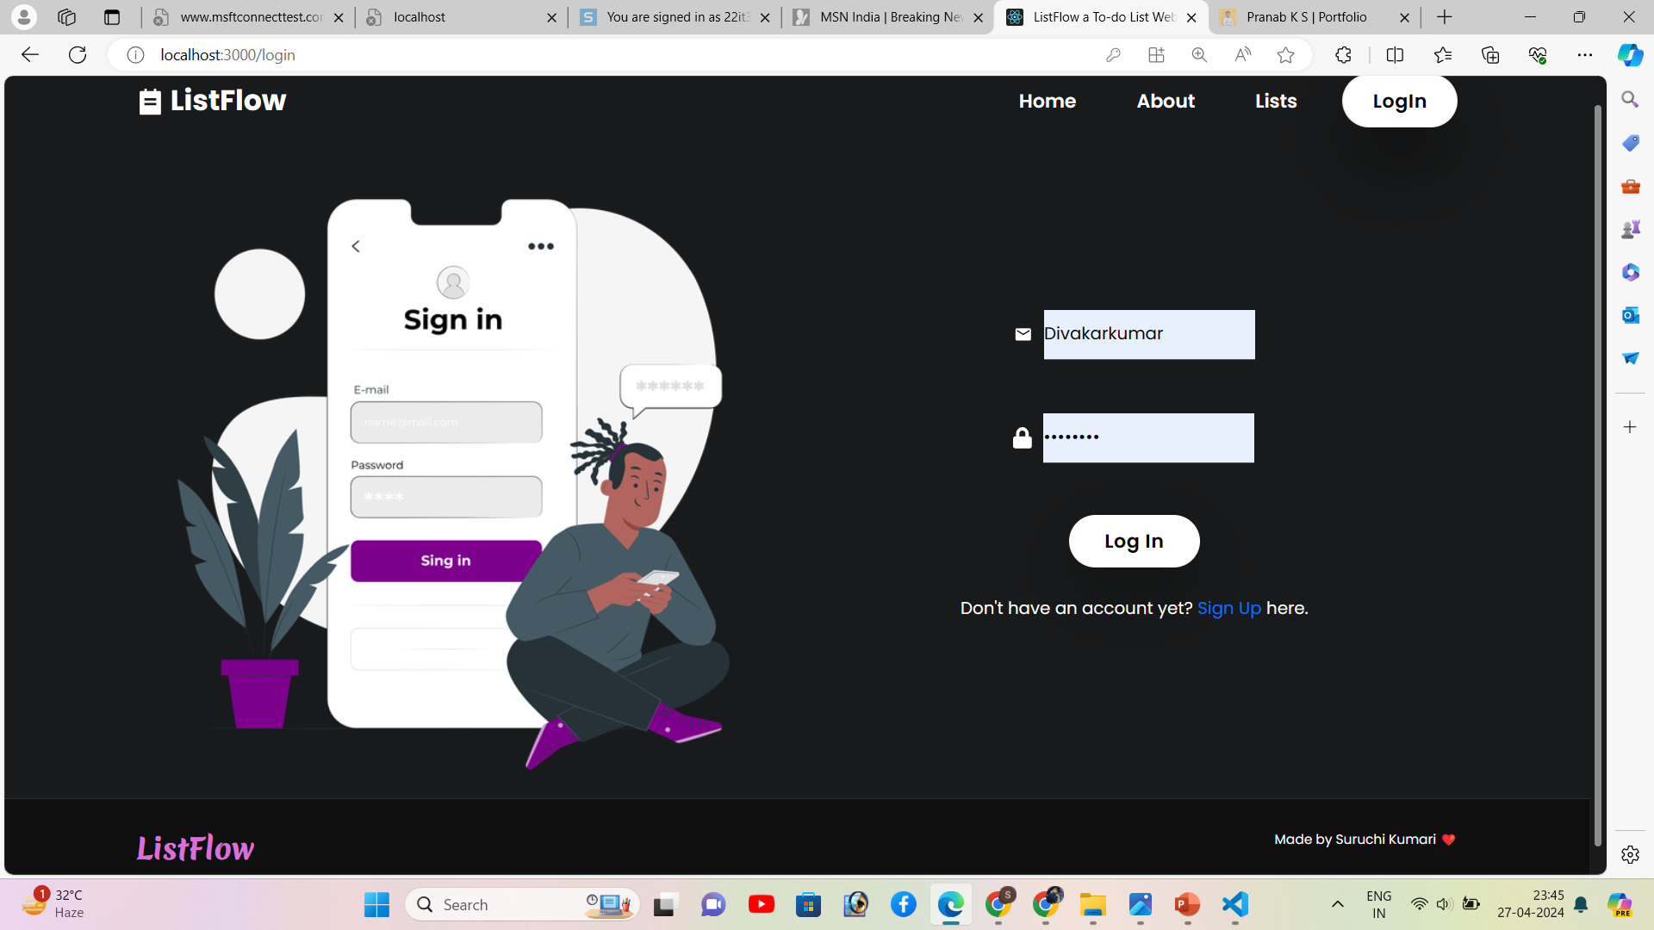

Slide 11
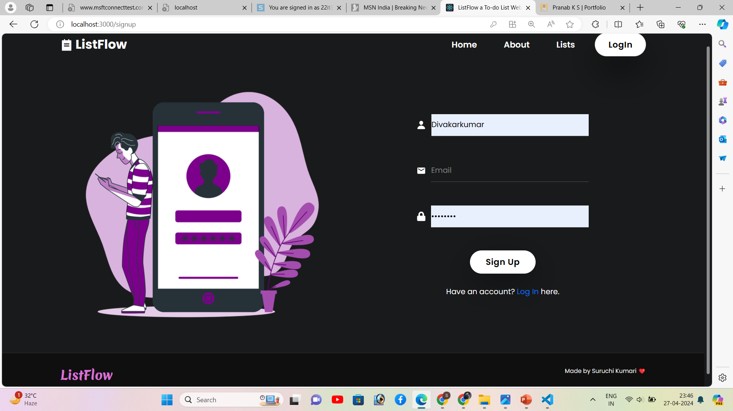

Slide 12
